Slide 1
Chapter 8 Analog-to-Digital Converter (ADC)

Slide 2
Why Analog-to-Digital Conversion?
In the physical world, everything is analog (continuous).
We need an analog-to-digital converter to translate analog signals to digital numbers so that the microcontroller can read and process them.

Slide 3
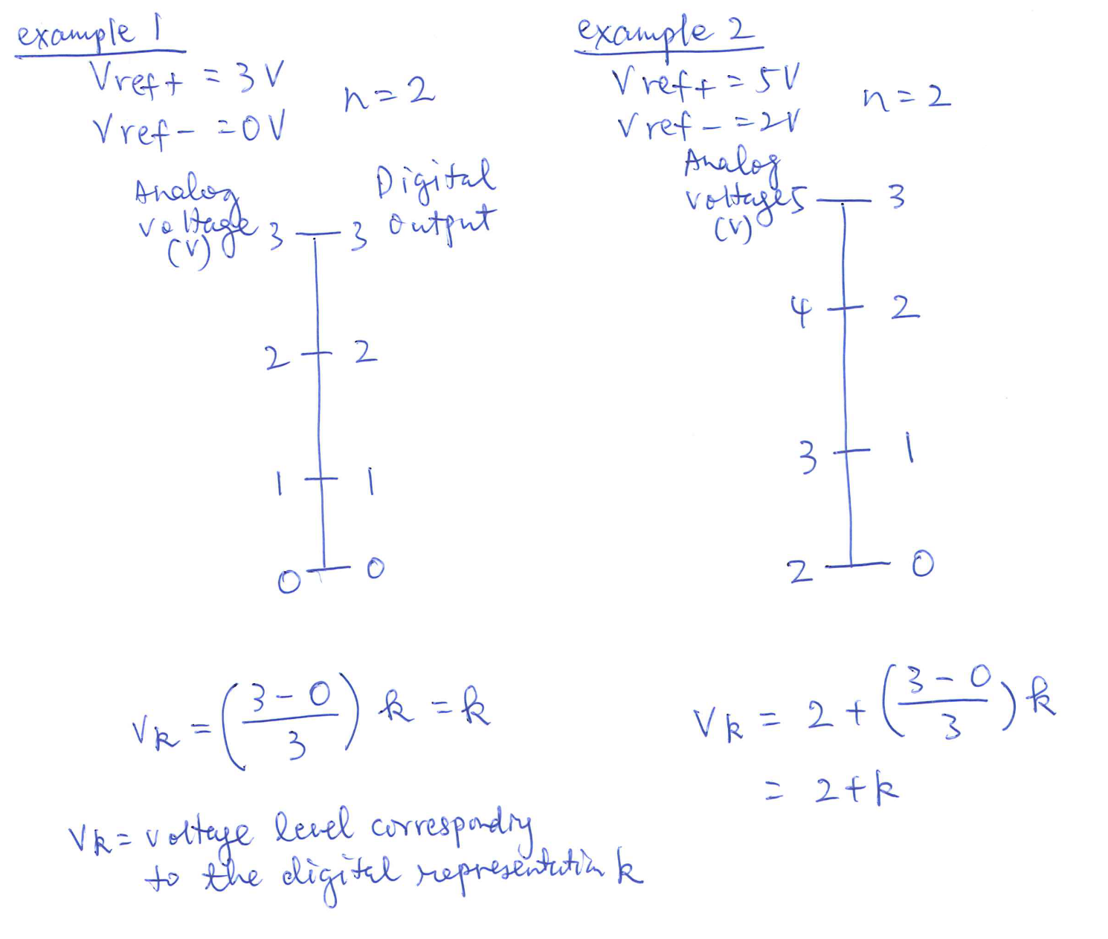
Example: 2-bit ADC

Slide 4
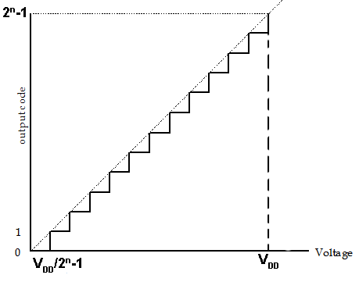
n-resolution ADC
 | Analog voltage (V) | Digital represen-tation
V_{REF-} | 0 | 0
V_{REF+} | V_{DD} | 2^{n}-1
V_{k} |  | k
Or in terms of V_{REF-} & V_{REF+}:
Notes:
The output characteristic of an ideal AID converter using n bits to represent the conversion result is shown. An n-bit A/D converter has 2^n possible output code values.
For a n-resolution ADC, there are in total 2^n levels. ADC conversion requires a negative voltage reference and a positive voltage reference. Level 0 represents the negative voltage reference and Level 2^n-1 represents the positive voltage reference. So we would ask, what voltage does Level k represent? Between Level 0 and 2^n-1, we have 2^n-1 intervals. Each interval represents Vdd/2^n-1 voltages. We are in Level k, Level k represents Vk

Slide 5
Examples
e.g., V_{REF-} = 0, V_{REF+} = 5V, 10-bit resolution ADC. Suppose the ADC results are as follows. What are the corresponding voltages?
20
V₂₀ = 20x5/(2¹⁰-1) = 0.0977V
499
V₄₉₉ = 499x5/(2¹⁰-1)= 2.43V
898
V₈₉₈ = 898x5/(2¹⁰-1)=4.38V

Slide 6
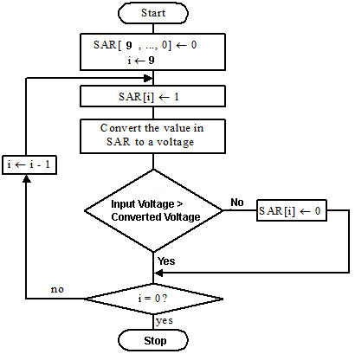
How can ADC be done?
Successive Approximation

Slide 7
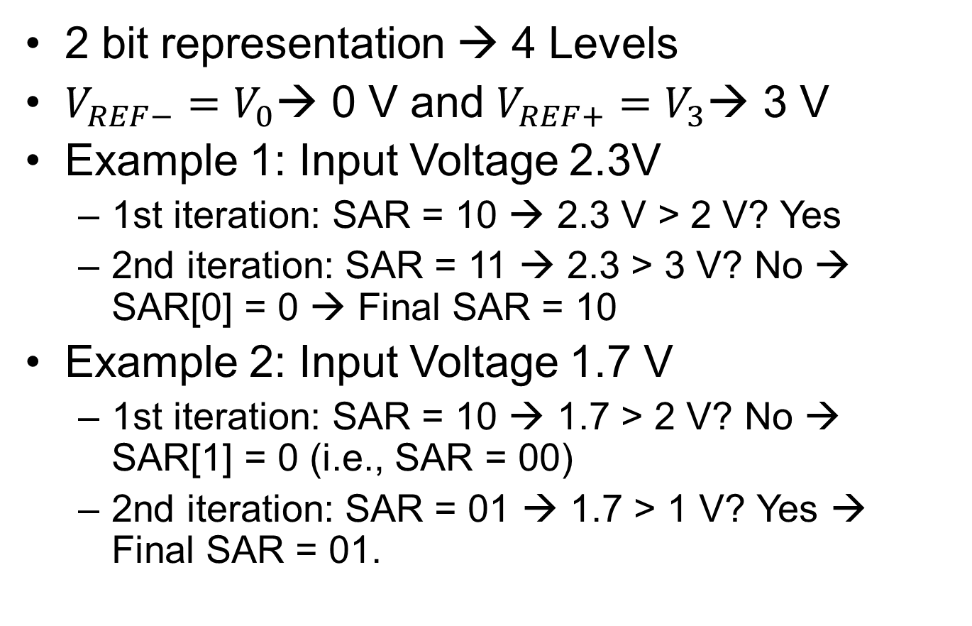
Examples of Successive Approximation

Slide 8
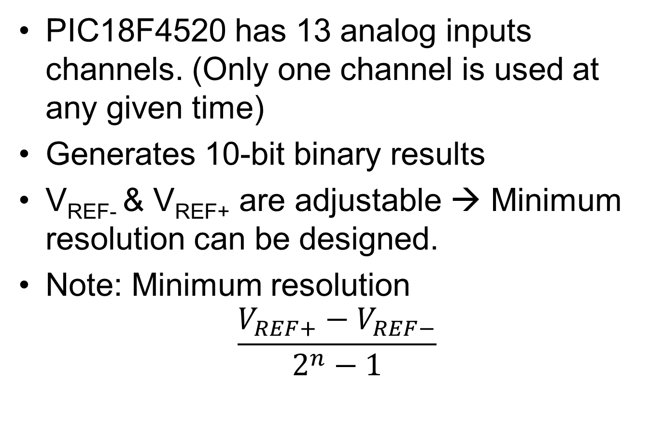
PIC18 ADC Module
Notes:
There is one ADC module in PIC18.
minimum resolution is Vref+-Vref-/4095

Slide 9
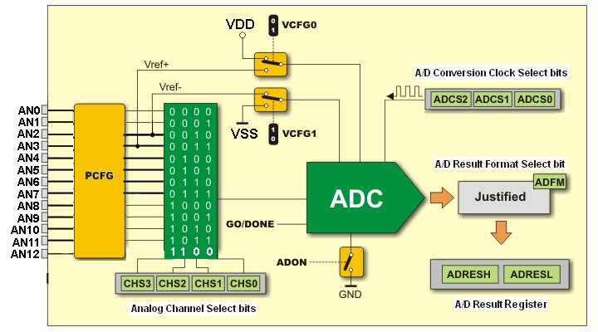
Block Diagram of PIC18 ADC

Slide 10
SFR involving in ADC
A/D Control Register 0 (ADCON0)
A/D Control Register 1 (ADCON1)
A/D Control Register 2 (ADCON2)
A/D Result High Register (ADRESH)
A/D Result Low Register (ADRESL)

Slide 11
ADCON0

Slide 12

ADCON0
CHS3:CHS0: Analog Channel Select Bits
PIC18F4520 has only 1 Analog-to-Digital unit
Can only select 1 input from AN0:AN12 to be sampled and converted
GO/DONE:
Setting this bit starts A/D conversion
Cleared when A/D conversion is done
ADON:
Power up (1)/Shut off (0) the ADC module

Slide 13
ADCON1

Slide 14

ADCON1
Voltage Reference Configuration bits
VCFG1: V_{REF-} source
1 = V_{REF-} (AN2)
0 = V_{SS}
VCFG0: V_{REF+} source
1 = V_{REF+} (AN3)
0 = V_{DD}
A/D Port Configuration bits
PCFG<3:0> – The input analog signal must be configured as an analog input.

Slide 15
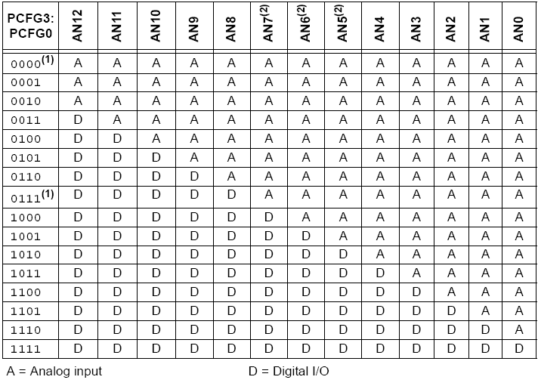
ADCON1: A/D Port Configuration bits

Slide 16
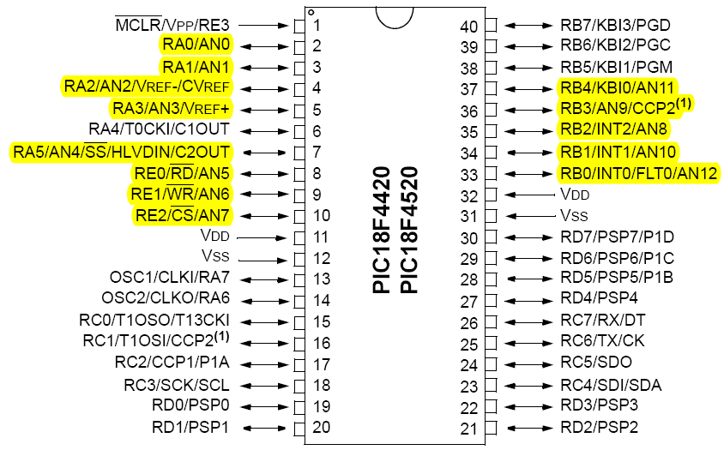
ADCON1: A/D Port Configuration bits
Do the following two lines sound familiar?
movlw 0x0F
movwf ADCON1
Notes:
You set all AN channels to be digital in all your lab exercises. Pins in microcontroller are multiplexed for different purposes. For example, Pin 2 is both analog channel 0 and 0 pin of PORT A. In all your labs, pin are used for digital I/O. That’s why you should set the last 4 bits of ADCON1 to be 1111.

Slide 17
ADCON2

Slide 18

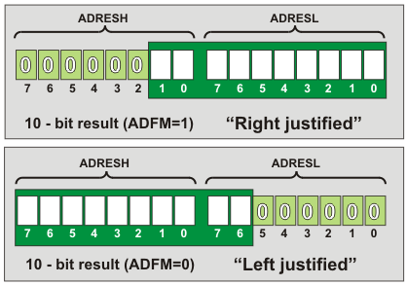
ADCON2
ADFM: A/D Result Format Select bit
Notes:
You have two bytes to store the result of the conversion. Two bytes have 16-bit but the result of the A/D conversion is only 10 bits. You can choose to display the result as right or left justified.

Slide 19
A/D Conversion Time: T_{AD}
T_{AD} = time required to complete 1-bit A/D conversion
Time required for one full 10-bit A/D conversion is 11 to 12 T_{AD} – Successive approximation
From the PIC18F4520 specification, T_{AD} must be between 0.7 – 25 μs.
T_{AD} can be specified from 2T_{osc} to 64T_{osc} by selecting the A/D Conversion Clock Select Bits (ADCS<0:2> in ADCON2).

Slide 20
How should T_{AD} be set?
e.g., If a 4MHz clock is installed, T_{osc} = 0.25μs.
The minimum T_{AD} that can be set is 4T_{osc}.
T_{AD} can be chosen from 4T_{osc} (1μs) to 64T_{osc} (16μs).

Slide 21
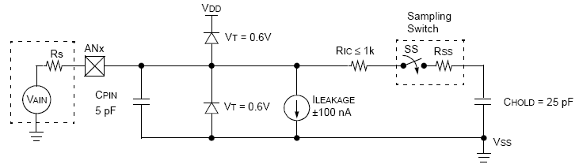
Sample-and-hold circuit
The analog input voltage will charge up C_{HOLD} to a steady state before ADC begins.
The time required to reach steady state depends on R_{s}, R_{IC,} R_{ss} and C_{HOLD.}
Notes:
In order to ensure that the analog input voltage is stable throughout the A/D conversion process, PIC18 has a sample and hold circuit. The capacitor holds the voltage to be converted into digital code. The charge-holding capacitor must be allowed to fully charge to the input channel voltage level.

Slide 22
A/D Acquisition Time (ACQT)
The minimum acquisition time (T_{ACQ}) for PIC18F4520 is 1.4μs.
ADC module will insert an acquisition time between the GO/DONE bit is set and when the conversion starts.
Suppose T_{AD} = 1μs. T_{ACQ} >= 2 T_{AD}
T_{ACQ} is set by setting ACQT<0:2> of ADCON2 (chosen as a multiple of T_{AD}).

Slide 23
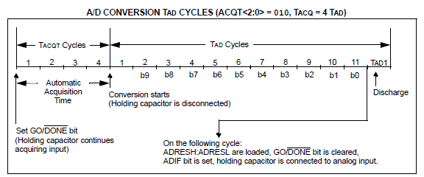
A/D Conversion Process
Set GO/DONE bit
Wait T_{ACQ} to charge up C_{HOLD}
C_{HOLD} is disconnected and ADC begins
11-12 T_{AD} is required for a 10-bit ADC
When finished:
ADRESH:ADRESL are loaded
GO/DONE bit is cleared
ADIF bit is set
C_{HOLD} is reconnected to the analog input

Slide 24
Example Use of the ADC
Main: movlw b'00001110' movwf ADCON1 movlw b'00000001' movwf ADCON0 movlw b'00010100' movwf ADCON2 clrf TRISD MainLoop: bsf ADCON0, GO adc_wait: btfsc ADCON0, GO bra adc_wait movff ADRESH, PORTD bra MainLoop | ;Set RA0 Analog Port, others Digital I/O ;Select ADC Channel 0, Enable ADC ; ADFM Left justified, ACQT 4TAD, FOSC/4 ; set PORTD output ; start Conversion ; adc_wait;wait ADC to be done ;display Top 8 bit

Slide 25
Example
Assume f_{OSC} = 4MHz, write a few
instructions to turn on and configure a PIC
ADC with the following requirements:
ADC converts the analog signal fed into Channel AN3.
ADC result is left justified.
Select V_{DD} and V_{SS} as reference voltages.
T_{AD} must be at least 2.5 μs.
T_{ACQ} must be at least 18 μs.

Slide 26
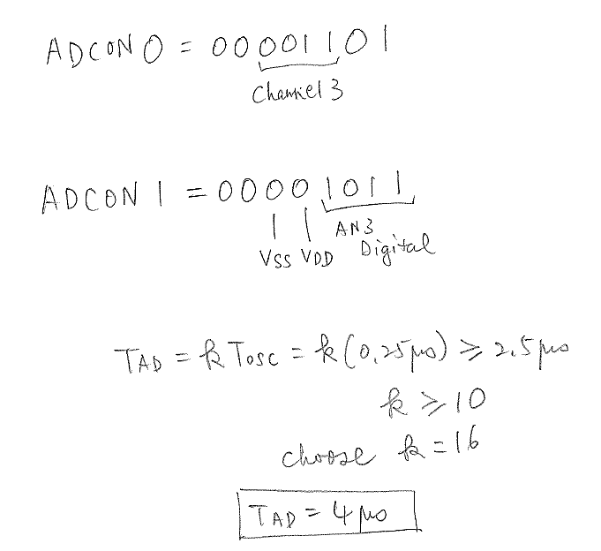
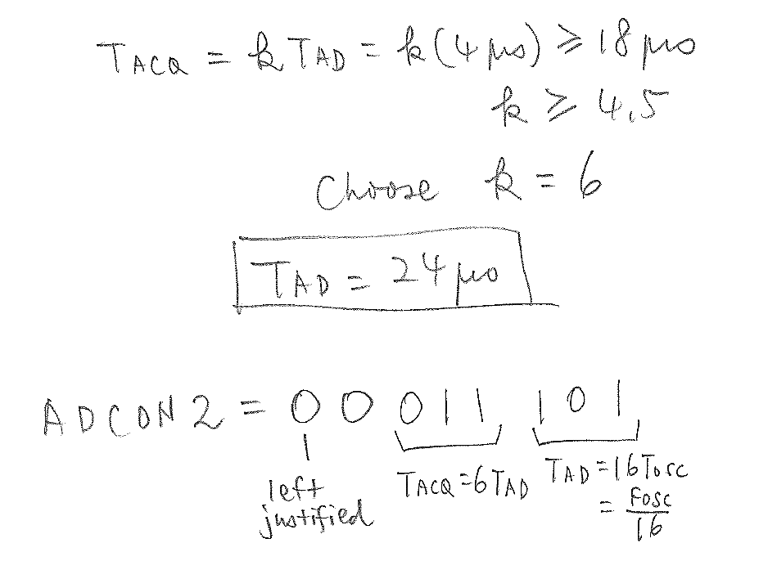

Example

Slide 27
You should be able to ...
Describe the roles of the following 5 registers: ADCON0, ADCON1, ADCON2, ADRESH and ADRESL in the A/D conversion. These registers specify the following options:
Which channel to convert?
Which channel should be set to accept analog input?
How to store the conversion result?
What is V_{ref+} and V_{ref-}?
What is the conversion time (T_{AD})?
What is the acquisition time (T_{ACQ})?

Slide 28
You should be able to ...
Explain the process of sampling analog voltage before A/D conversion.
Explain why an acquisition time is needed before A/D conversion.
Describe the successive approximation algorithm.
Describe the whole A/D conversion process.

